Slide 1
Neural Networks and Deep Learning
Ahmad Raza
2101194

Slide 2
Data Partition and Processing
377953 rows of data
Null Values Removed
Duplicates Removed
Data Scaled between 0 and 1 using MinMaxScalar
Data Splitted into test, training and validation using train_test_split
70 percent training data
Remaining 30 percent splitted equally between validation and testing
6 csv files generated containing X and Y values

Slide 3
Architecture and Topology
2 Input Neurons
2 Output Neurons
12 Hidden Layer Neurons
1 bias in Input layer
1 bias in hidden layer
Feed forward
Error Calculation
Back propagation
RMSE for training data
RMSE for unseen(validation data)
Writing final weights into a text file

Slide 4
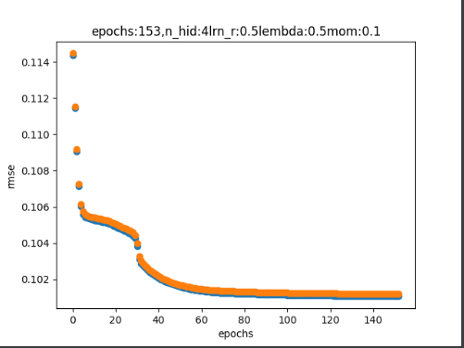
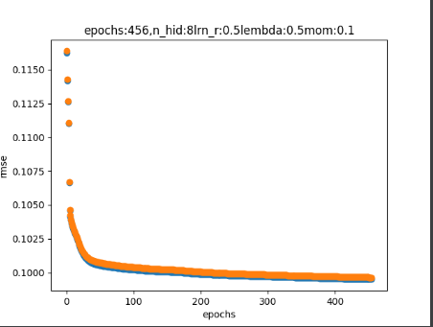
Architecture and Topology
Training and testing done against 3 different values of hidden layer neurons

Slide 5
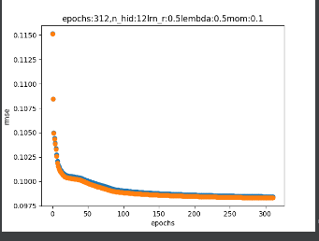
Architecture and Topology
Training and testing done against 3 different values of hidden layer neurons

Slide 6
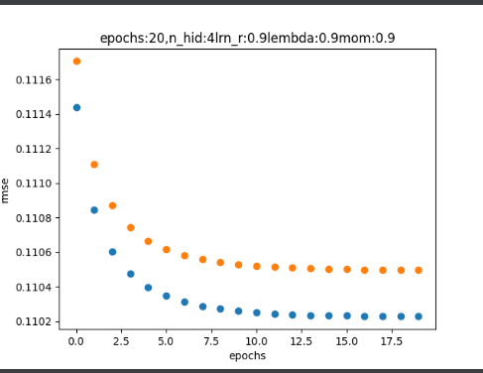
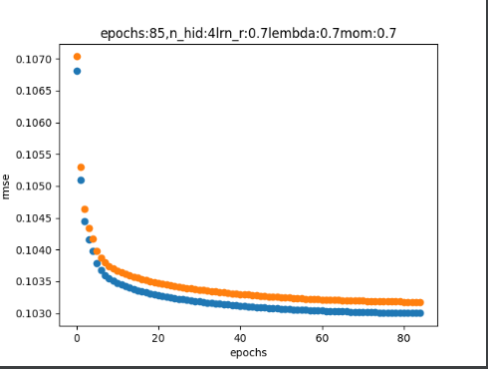
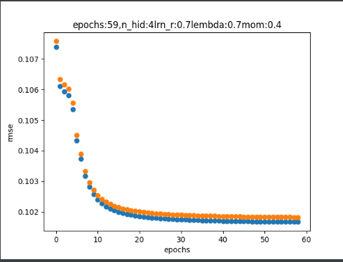
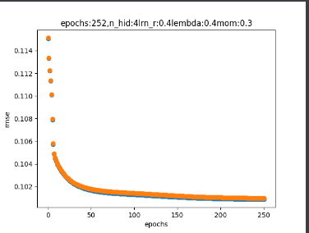
Parameter Selection

Slide 7
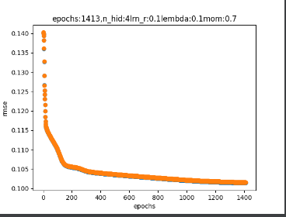
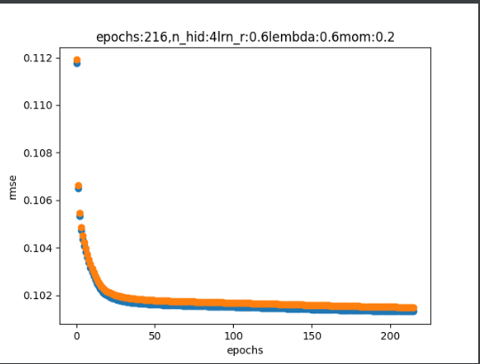
Parameter Selection

Slide 8
RMSE Values
Whenever the curve becomes flat we stop after a few iterations
For that purpose, errors have been rounded off to 6 decimal places.

